Slide 1
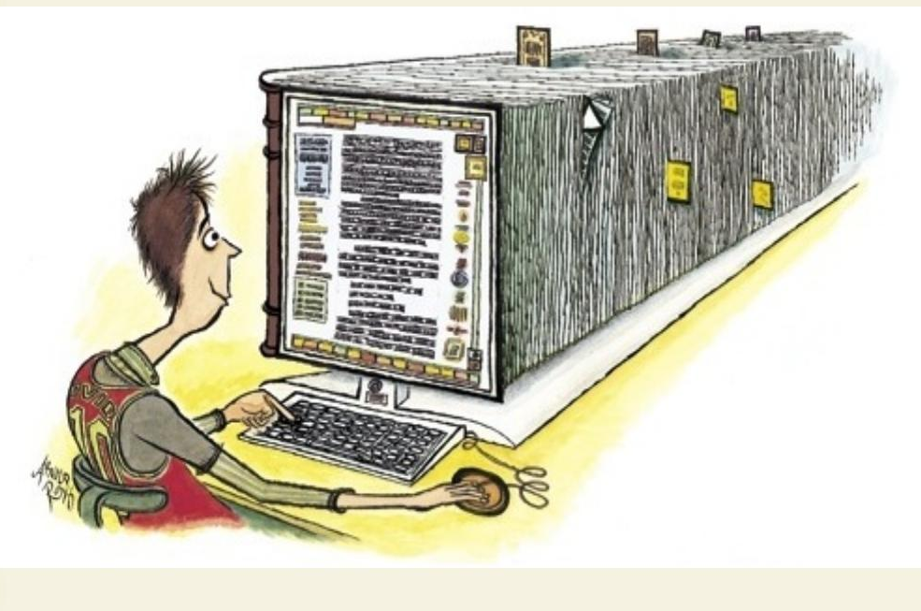
Computational Work with Very Large Text Collections
Google Books, HathiTrust, the Open Content Alliance, and the Future of TEI
John Unsworth
unsworth@illinois.edu
Text Encoding Initiative Consortium
Annual Members’ Meeting
Ann Arbor, Michigan
November 13, 2009
http://www.newyorker.com/reporting/2007/02/05/070205fa_fact_toobin

Slide 2

Topics & sub-topics

Slide 3
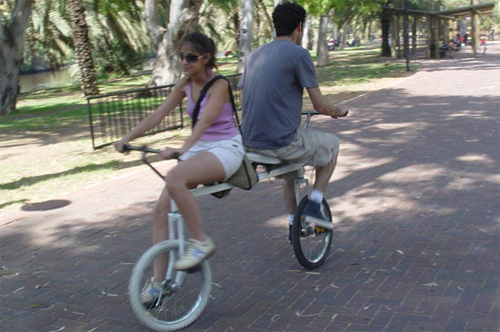
Interoperability: Early Days
The Text Encoding Initiative grew out of a planning conference held at Vassar College in November 1987.
The outcome of the conference was a set of principles, the first of which were:
The guidelines are intended to provide a standard format for data interchange in humanities research.
The guidelines are also intended to suggest principles for the encoding of texts in the same format.
http://bit.ly/CFFM3
http://bit.ly/Gx4iM

Slide 4

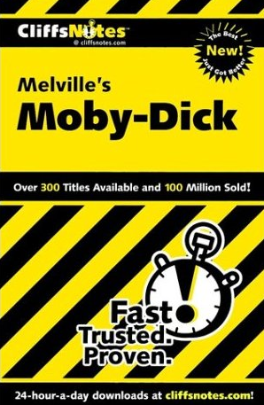
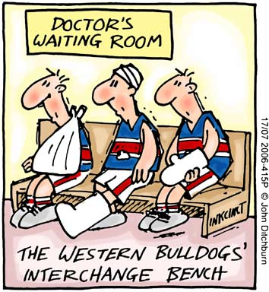
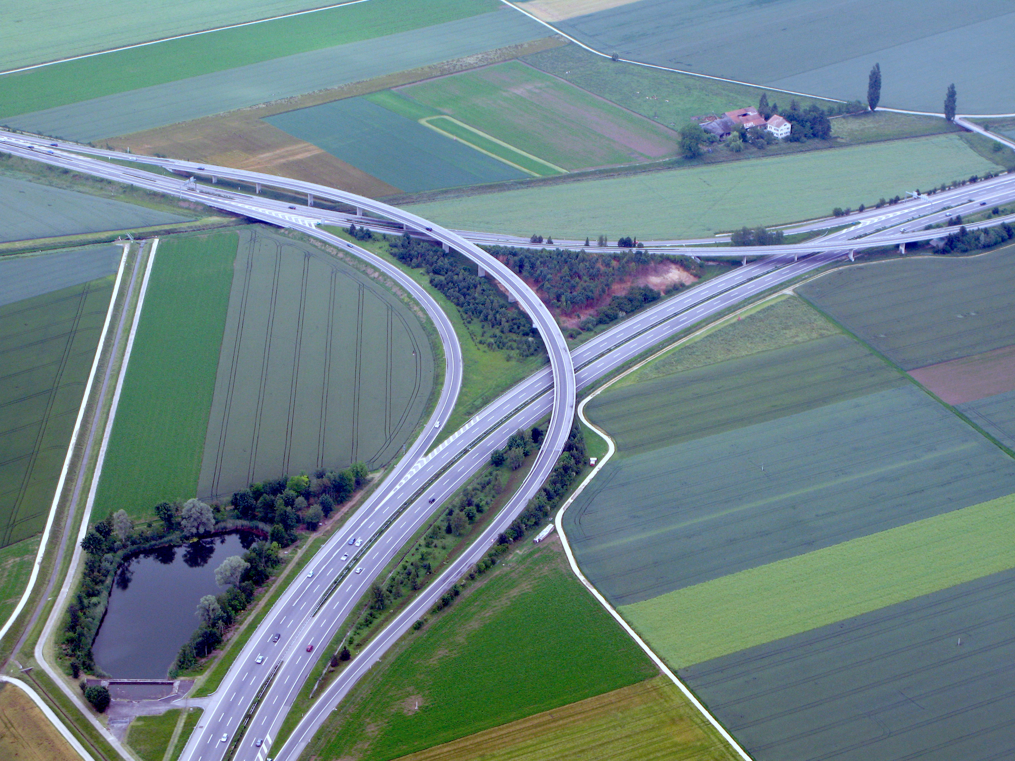

Slide 5
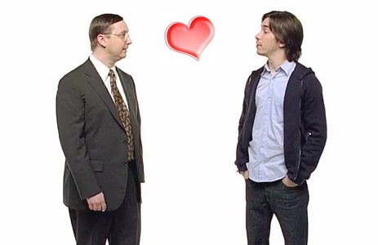
Interoperate: some meanings

Slide 6

Interchange ≠ Interoperability
Current Draft
Best Practices for TEI in Libraries
General Recommendations
The goal of the TEI is interchange, not interoperability. While seamless interoperability of texts created by different organizations is an unobtainable goal, use of a common markup vocabulary and syntax greatly aids interchange. Nevertheless, keep in mind that others—even within your organization—may use your texts in the future for other uses than you intended in your encoding.
http://bit.ly/2sXk5k

Slide 7
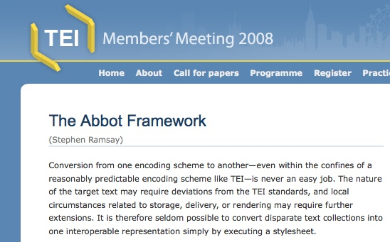
Abbot: The unobtainable, obtained
Abbot harvests TEI-like XML schema to produce stylesheets that convert documents marked up in other forms of TEI into TEI-A, and then it validates converted files.
Developed by Brian Pytlik-Zillig, Stephen Ramsay, and Martin Mueller for The MONK Project.

Slide 8
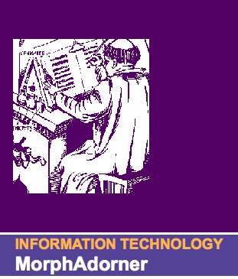
Morphadorner
MorphAdorner provides methods for adorning text with standard spellings, parts of speech and lemmata. MorphAdorner also provides facilities for tokenizing text, recognizing sentence boundaries, and extracting names and places.
Developed by Phil Burns, at Northwestern, in conjunction with the WordHoard, VOSPOS, and MONK projects.

Slide 9

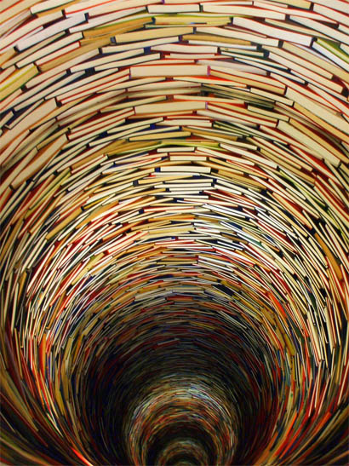
MONK
Texts from Seven Collections Combined,
Using Abbot and Morphadorner
Early English Books Online (TCP)
Eighteenth-Century Collections Online (TCP)
!9th-Century Fiction (ProQuest)
Documenting the American South (UNC)
Wright American Fiction (Indiana)
Early American Fiction (UVa)
Shakespeare (Mueller)

Slide 10
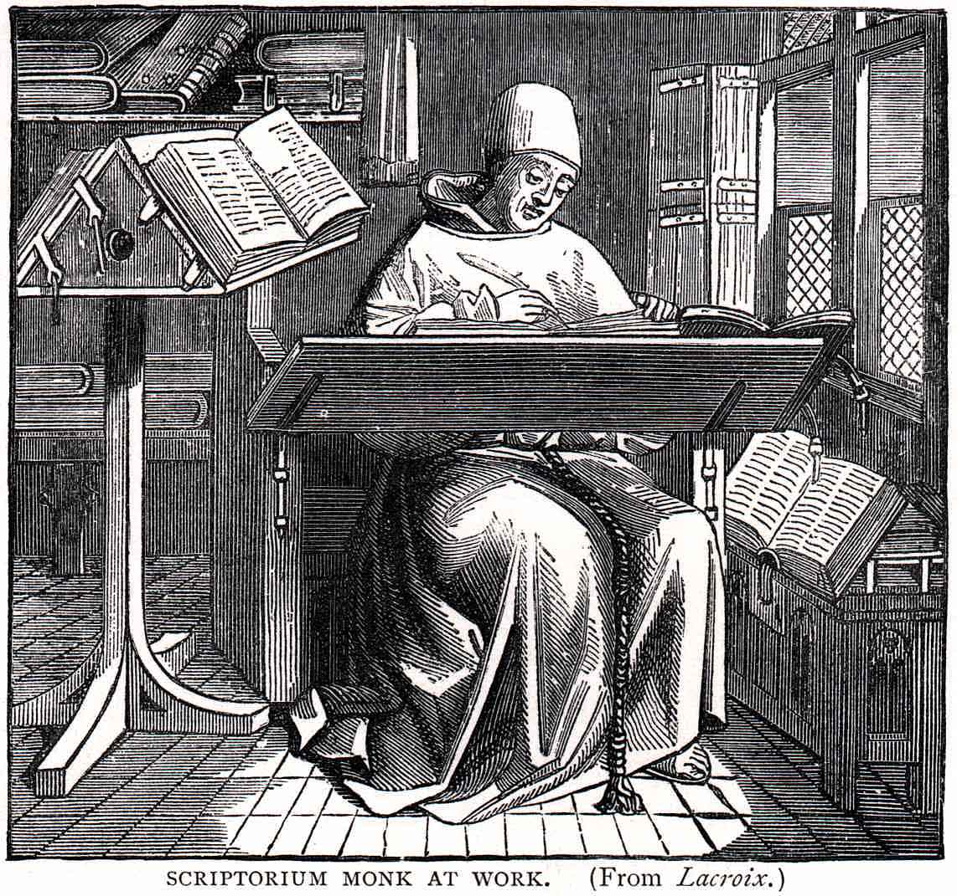
150,000,000 Words From 1500 Texts by 800 Authors 1600-1900 British and American Fiction, Non-Fiction, Poetry, Drama Uniform TEI-A XML, POS-tagged Available for Text-Mining Under InCommon Authentication To 50,000 Faculty and 385,000 Students in 14 Universities As a Library Service Later this month…

Slide 11
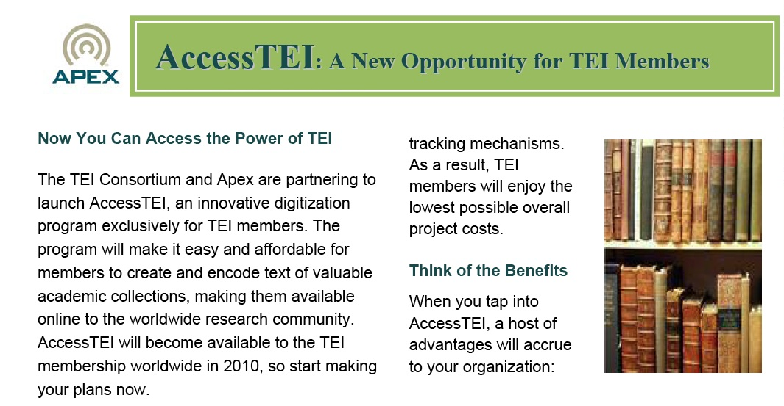
AccessTEI will produce texts in TEI-Tite. TEI-A and TEI-Tite are closely related. AccessTEI, plus Abbot, plus Morphadorner will make it relatively easy to prepare locally held materials in formats that will interoperate (not merely interchange) with other collections.

Slide 12
What’s a “Very Large Collection”?
Google Books = 10,000,000 volumes as of October, 2009
HathiTrust = 4,587,975 volumes as of November 12, 2009

Slide 13
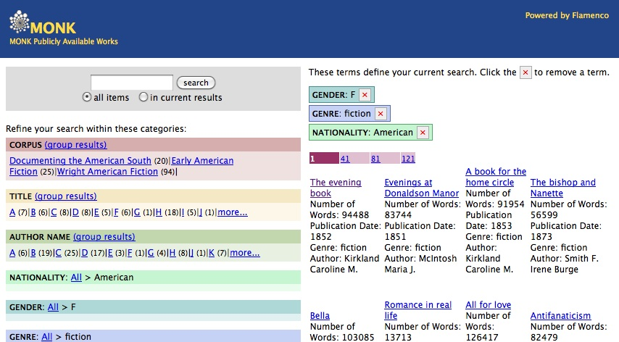
(we’re going to need faceted browsing)

Slide 14
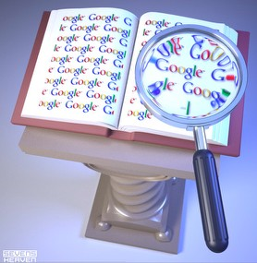
Google Books Research Centers
At least two Google Books Research Centers were to have been established by the originally proposed settlement between Google and publishers, institutional hosts to be chosen by “the community” (of libraries who contributed materials) in a process yet to be determined, with several million dollars in support for each provided by Google.

Slide 15

Non-Consumptive Research
“Research in which computational analysis is performed on one or more Books, but not research in which a researcher reads or displays substantial portions of a Book to understand the intellectual content presented within the Book.”

Slide 16
Non-Consumptive Research is:
Image analysis and text extraction, including image de-skewing and optical character recognition
Textual analysis and information extraction, including concordance development, collocation extraction, citation extraction, automated classification, entity extraction, and natural language processing.
Linguistic analysis, automated translation, indexing and search

Slide 17
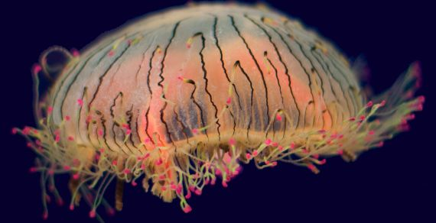
Our Lucky Day?
The original settlement was thrown out by Judge Denny Chin, after objections from dozens of governments and hundreds of organizations and individuals. An amended settlement, reached in consultation with the US Department of Justice, is due to be filed today, Friday the 13th, 2009. Best source of updates: James Grimmelmann’s blog, The Laboratorium.

Slide 18
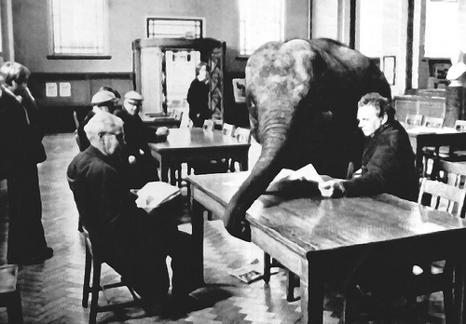
The HathiTrust: there’s an Elephant in the Library
A shared digital repository set up by CIC libraries who contributed to Google Books, to store digitized materials returned to them from that process.
Also meant to include materials digitized by member libraries for the Open Content Alliance as well as other, possibly local, inititiatives (e.g., materials digitized under Access TEI).

Slide 19


Call for proposals to develop a Research Center
Members of the Research Center working group
Steve Abney, University of Michigan
Jack Bernard, University of Michigan
Geoffrey Fox, Indiana University
David Goldberg, University of California Irvine
Robert McDonald, Indiana University
Qiaozhu Mei, University of Michigan
Shawn Newsam, University of California Merced
John Ober, California Digital Library
Beth Plale, Indiana University
Scott Poole, University of Illinois
Sarah Shreeves, University of Illinois
John Unsworth, University of Illinois
John Wilkin, University of Michigan
Submitted October 29, 2009, to the HathiTrust Executive Committee by
Kat Hagedorn
Jeremy York
Melissa Levine

Slide 20
What’s in the Research Center?
The Research Corpus
The HathiTrust Corpus
…which will be composed of public domain and in-copyright works digitized by Google. The in-copyright works are defined as Protected under the terms of the Settlement and carry restrictions over and above those imposed by copyright law (Appendix A contains a full list of definitions used in this document). The Research Corpus will only be created if the Settlement agreement is approved. [Under these circumstances, much of the HathiTrust In-copyright Data would be subject to the terms of the Settlement as Protected Data ]
…which is composed of Public Domain, Google Public Domain, Open Access, and In-copyright Data. The HathiTrust Corpus will exist regardless of what happens with the Settlement. [B]ecause of the large amount of content Google has scanned from HathiTrust institutions…perhaps more than 80% of the material in the HathiTrust Corpus would also be represented in the Research Corpus if the Settlement were approved.

Slide 21
Proposals
The HathiTrust Executive Committee is calling for full proposals from interested HathiTrust institutions for the design, development and ongoing support of a HathiTrust Research Center.
Proposals should address:
Research and Demand (actual research uses should drive everything)
Structure of the Research Center (technical architecture, tools, access)
Access to, and use and management of, derived research results
Legal & security concerns (auditable protection of in-copyright material)
Governance and funding models and approaches to sustainability (including budget and sources of funding)

Slide 22
Research Uses
Aggregation/Distillation – raw texts or abstracts covering particular topics or types of materials are reduced to subsets or databases of interest that can be used by one or multiple researchers
Development of Tools for Research – much of the research above requires textual analysis, entity extraction, aggregation of data, and the representation and analysis of results.

Slide 23
Research Uses
Collaboration –, the Center must offer the ability to share processes, results, and communication with individuals and groups in a secure manner.
Miscellaneous additional needs and concerns of researchers, e.g.
The ability to include additional data.
The ability to have access to both raw and pre-processed texts.

Slide 24
Research Center Should Provide:
Non-consumptive access to in-copyright works
Reading (i.e., consumptive) access to in-copyright works, via an Institutional Subscription to Google Books
Consumptive and Non-consumptive access to Public Domain, Google Public Domain, and Open Access Data
Infrastructure to receive, share, store, and in some cases provide access to, results of research
Appropriate security for all Research Center data

Slide 25
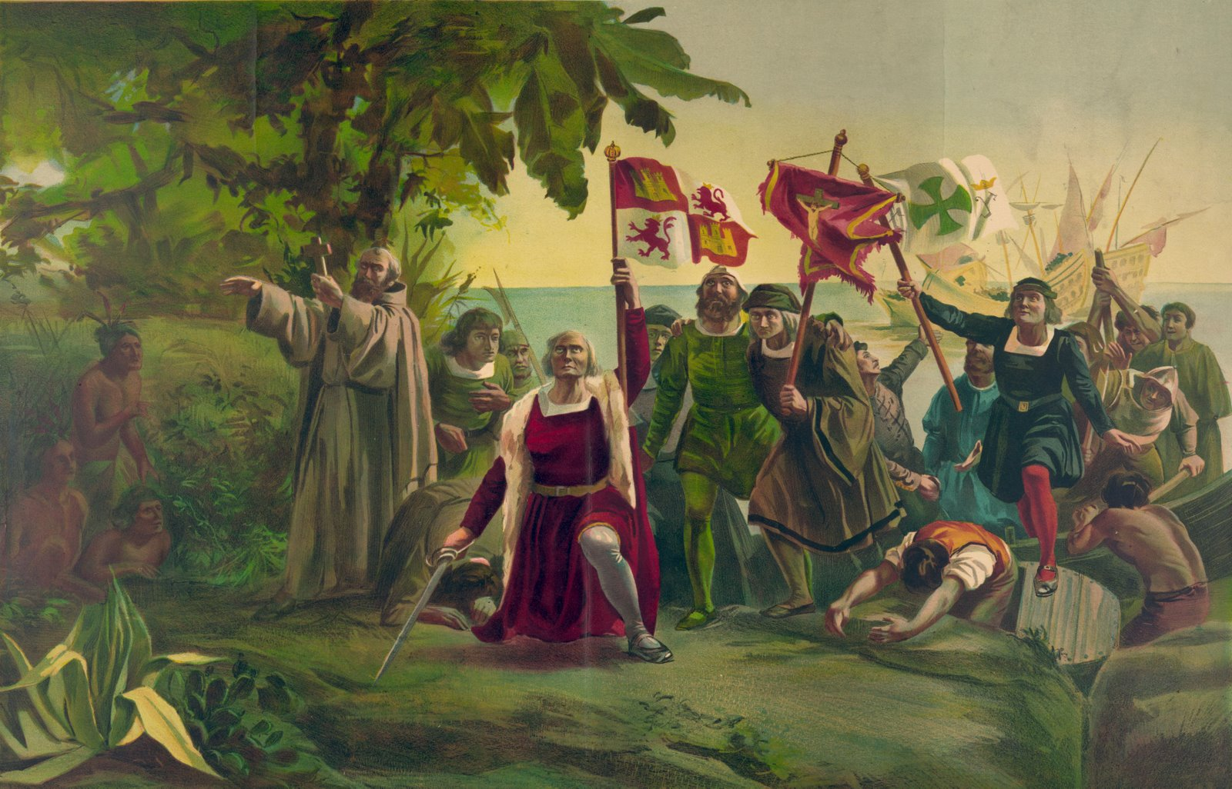
Discovering (?) New Worlds

Slide 26
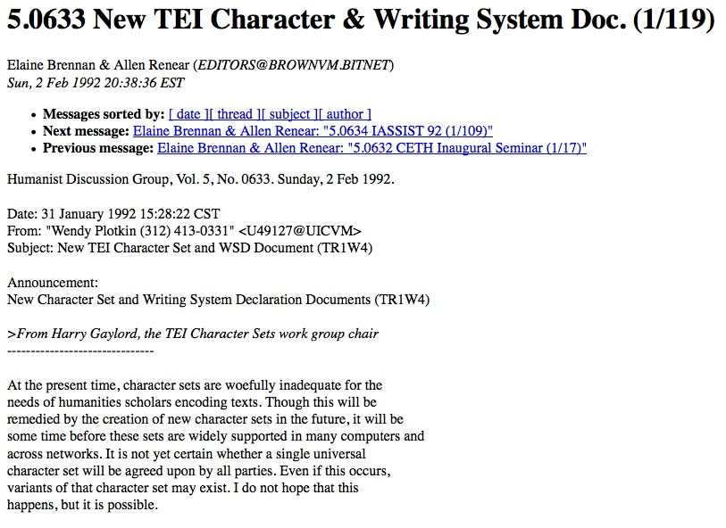
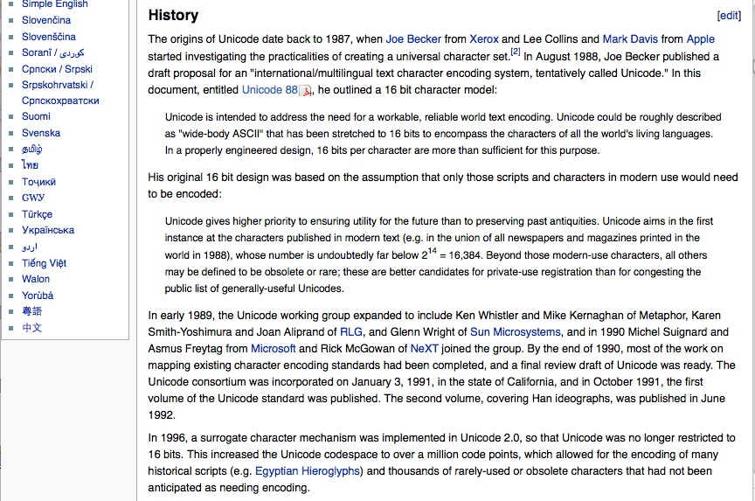
Writing Systems

Slide 27
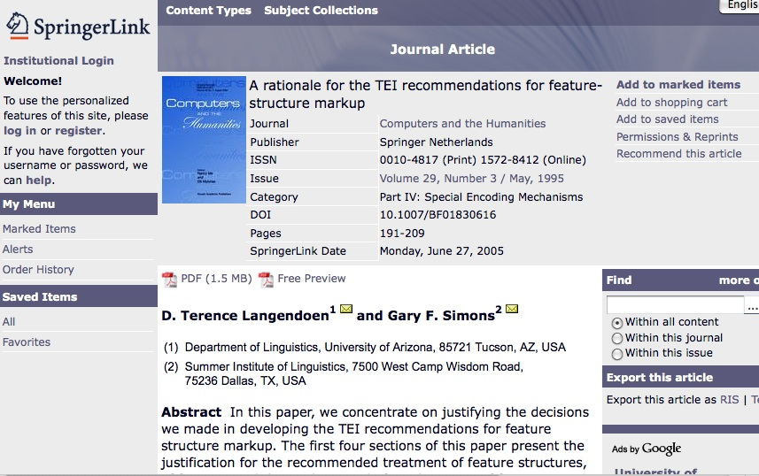
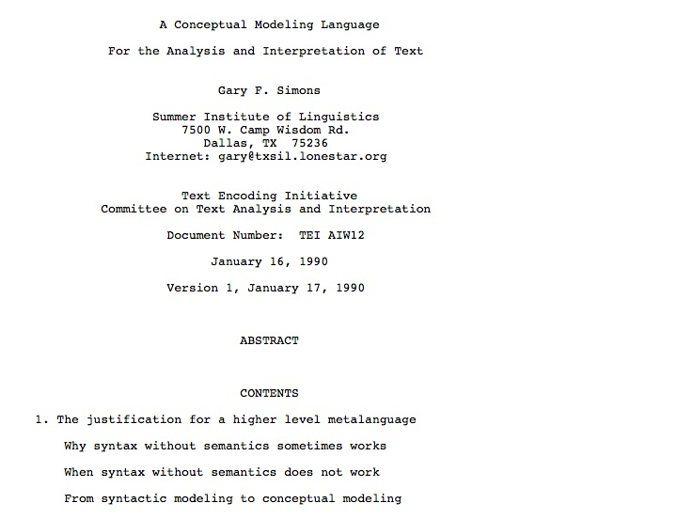
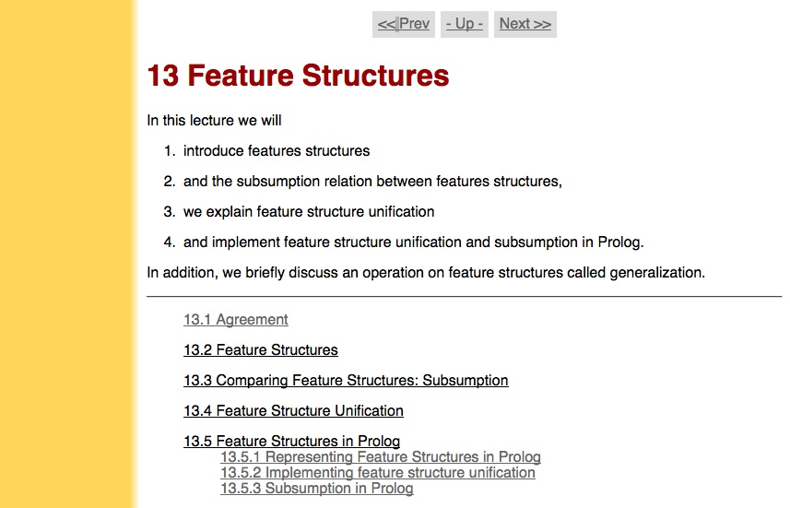
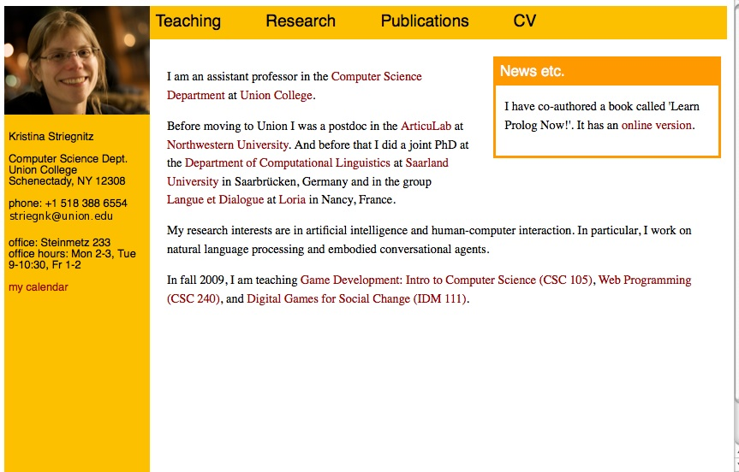
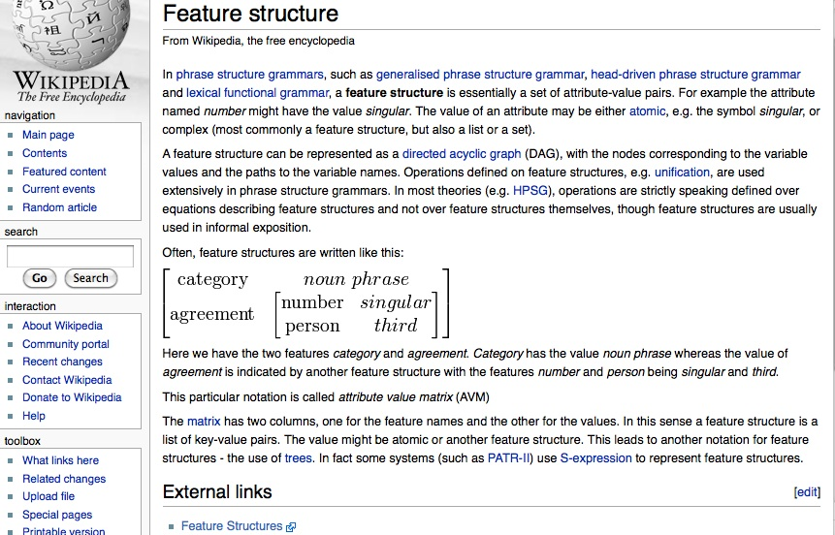
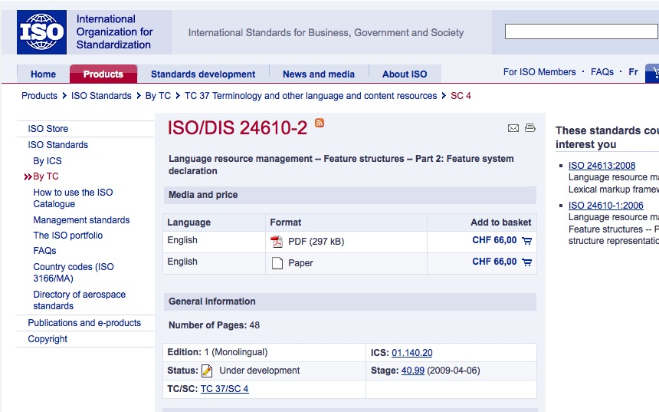
Feature Structures

Slide 28
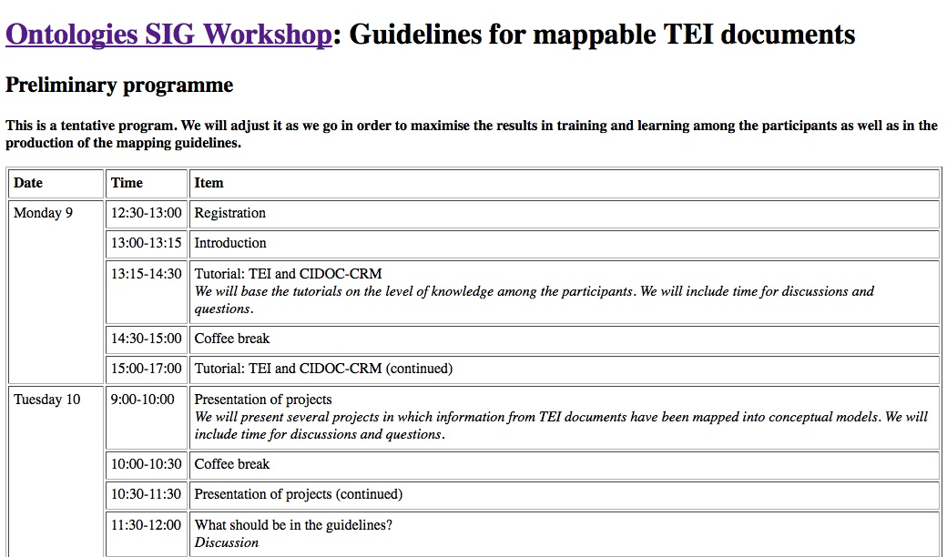
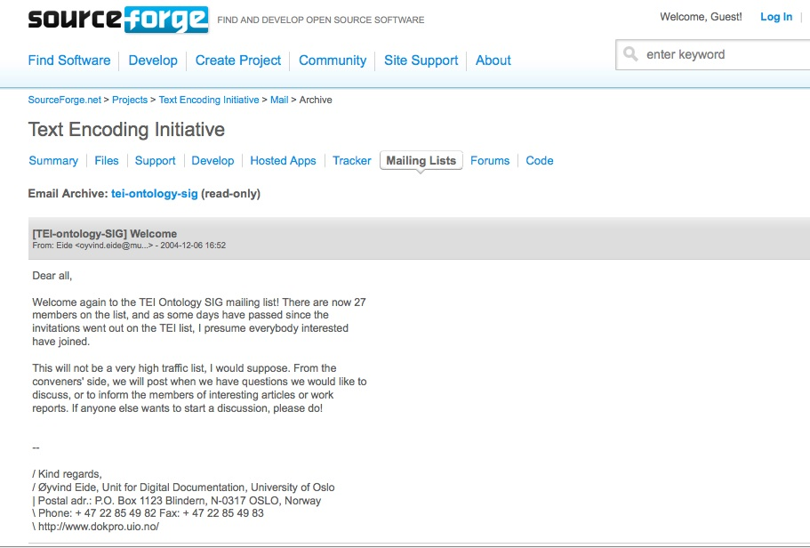
TEI and Ontologies

Slide 29
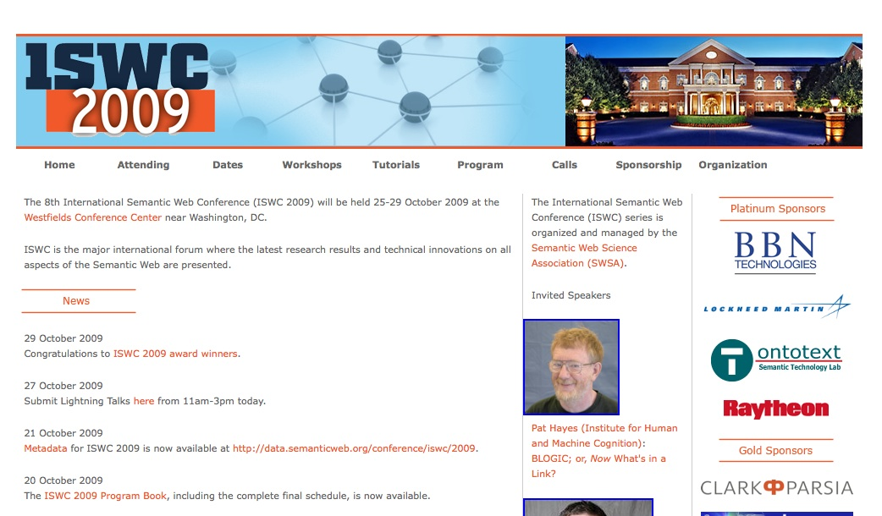
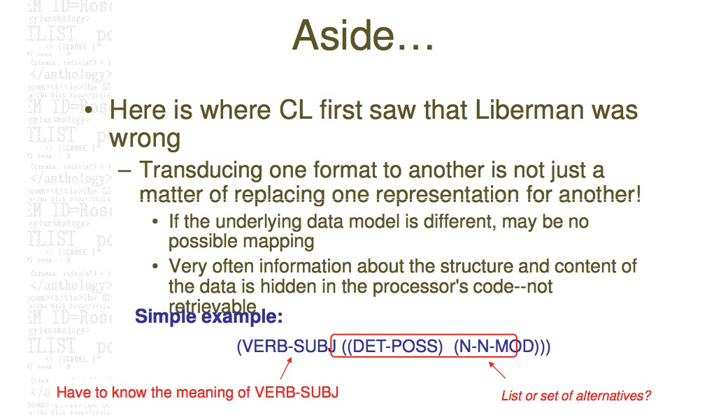
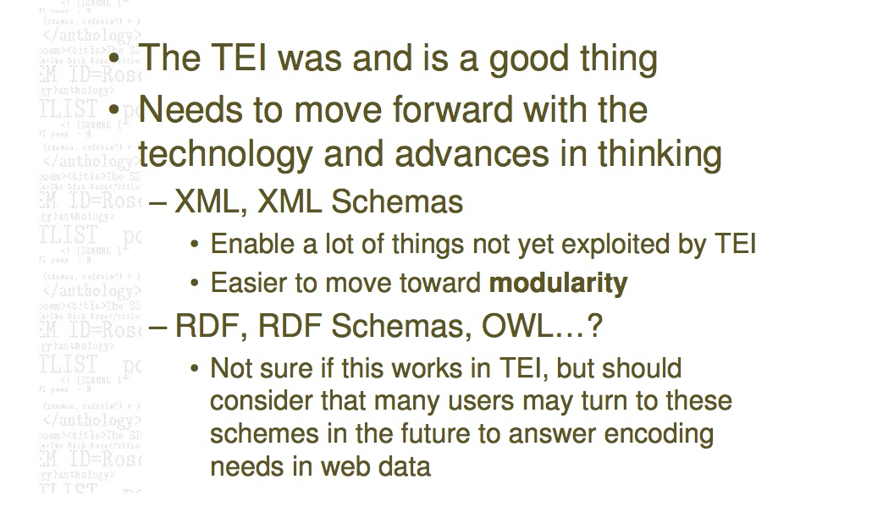
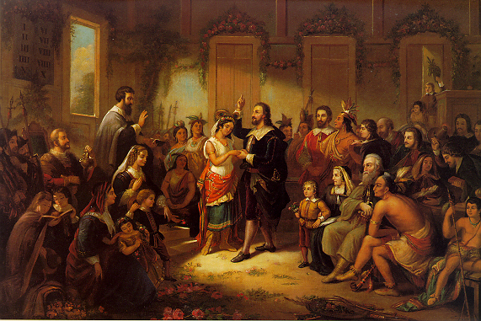
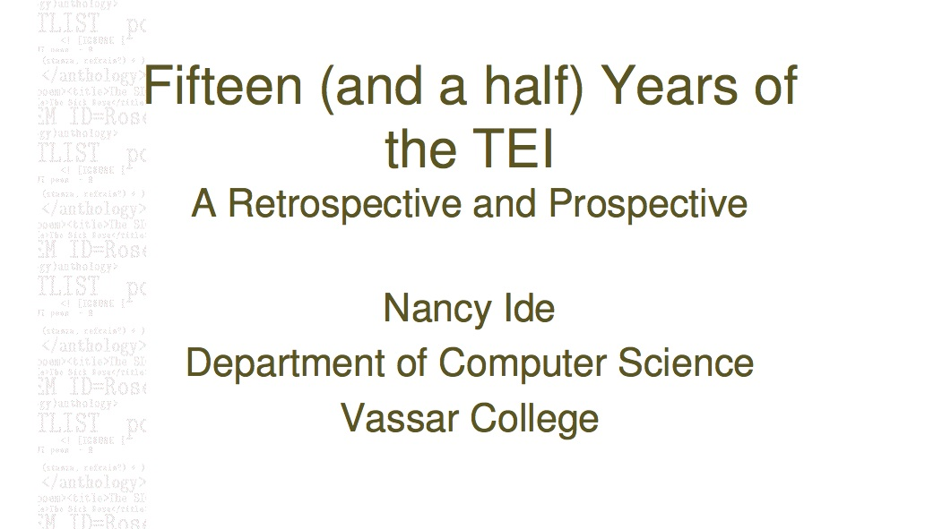
Semantic Web
Are we the Indians?

Slide 30
Thank You
unsworth@illinois.edu

